Slide 1


Slide 2
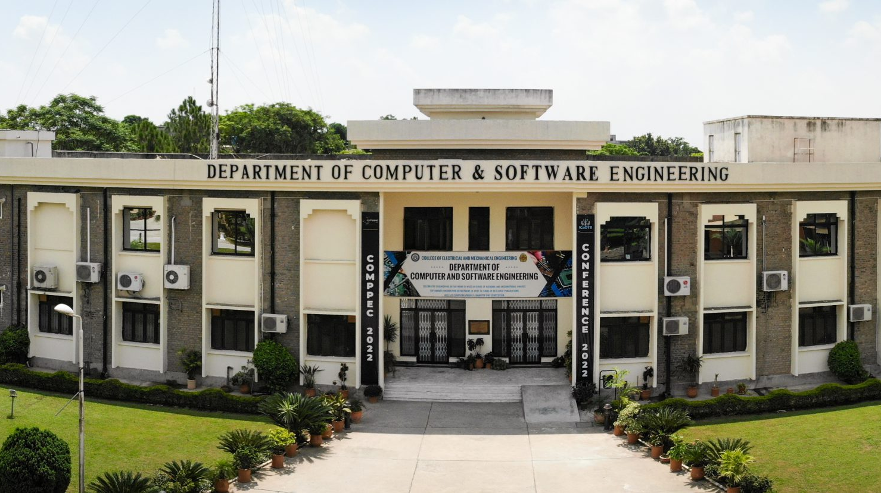
RISETECH COMPUTER ENGINEERING DEPARTMENT NUST EME COLLEGE(ORGANIZATION
PRESENTED BY:
HUZAIFA SHAHBAZ (21-CE-009)
AQSA SHAH(21-CE-039)
PRESENTED TO:
Col(R)Abdul Aleem

Slide 3
OUTLINES
ABSTRACT
INTRODUCTION OF THE ORGANIZATION
GENERAL OPERATIONAL COMPONENTS
WORKPLACE-WISE HAZARDS IDENTIFICATION AND RISK ASSESSMENT
MITIGATION/ELIMINATION STRATEGY(ISO 45001 AND ISO 14001 COMPLIANT)
ISO 45001 COMPLIANCE CHECKLISTS
ISO 14001 COMPLIANCE CHECKLISTS
ISO 45001:HAZARDS AND SAFETY REQUIREMENTS
ISO 14001:HAZARDS AND SAFETY REQUIREMENTS
CONCLUSION
REFERNCES

Slide 4
ABSTRACT
In this semester project our organization RISETECH COMPUTER ENGINERRING DEPARTMENT NUST EME COLLEGE.
Under the dispensation of the HSE development program of the college of electrical and mechanical engineering-national university of sciences and technology, this group audit for RISETECH is cross-sectional and aimed at auditing the health, safety, and environmental practices within the organization.
Compliance to international best practice by way of the iso 45001:2018 occupational health and safety management systems (OHSMS) and iso 14001:2015 environmental management systems (EMS) standards is strictly followed during the audit, which also touches compliance with other key area audits that will include identifying hazards in the workplace, assessing risks, and legal and regulatory compliance, along with a review of existing safety and environmental controls.

Slide 5
INTRODUCTION TO ORGANIZATION
RISETECH, a research unit within the computer engineering department at NUST college of EME, concentrates on academic research, prototyping embedded systems, developing iot solutions, and integrating hardware and software.
PURPOSE OF THE AUDIT
The health, safety, and environment (HSE) audit evaluate RISETECH workplace safety practices and environmental compliance, identifying potential hazards, assessing risks, and recommending mitigation strategies in accordance with iso 45001:2018 and iso 14001:2015 standards, ensuring personnel safety and sustainable environmental practices.

Slide 6
INTRODUCTION TO ORGANIZATION
OBJECTIVES OF THE AUDIT
Examine the present health, safety, and environmental conditions within the research and development facility.
Recognize and assess potential risks to health, safety, and the environment that may arise from regular operations, equipment usage, and workspace conditions.
Assess the lab's existing procedures in light of the requirements outlined in ISO 45001 and ISO 14001, identifying both its strengths and areas that require enhancement.
Suggest practical, affordable measures to mitigate or eliminate hazards, ensuring enhanced safety, reduced environmental impact, and long-term sustainability.

Slide 7
INTRODUCTION TO ORGANIZATION
SCOPE OF THE AUDIT
Workplaces and administrative areas.
Server rooms and its infrastructure zones.
Research facilities.
Workshops and equipment storage locations.
These regions are evaluated for potential risks, compliance gaps, emergency readiness, and overall adherence to HSE best practices.

Slide 8

GENERAL OPERATIONAL COMPONENTS
Labs and Hardware Prototyping Stations This tool is employed for circuit design, sensor integration, and practical testing of embedded devices.
Software Development and Testing Zones The system is furnished with desktop systems for coding, simulation, and debugging software components.
Soldering and PCB Manufacturing Area The system is furnished with desktop systems for coding, simulation, and debugging software components.
Power Supply Units and Test Benches The product comprises programmable power supplies, multimeters, oscilloscopes, and electronic loads.
Storage for Electronic Components and Chemicals Includes cabinets for microcontrollers, sensors, resistors, and chemical agents utilized in the cleaning of pcb components.
Server and Networking Racks It encompasses the provision of backend services, hosting in local areas, and the management of iot cloud platforms.
Waste Disposal Area (E-waste and General Waste) The person is accountable for disposing of different lab waste, such as printed circuit boards, resistors, batteries, and general lab waste.

Slide 9
WORKPLACE WISE-HAZARDS IDENTIFICATION AND RISK ASSESSMENT
WORKPLACE | HAZARDS IDENTIFIED | CAUSES | EFFECTS
Soldering station | Fume inhalation, burns, fire hazards | Poor ventilation , mishandling of hot tools | Respiratory problems , skin injuries ,fire risk
Electrical Bench | Electrical shock , short circuits , tripping hazards | Exposed wiring, overload circuits | Equipment failure, injuries , possible fire
Software Dev Area | Eye strain, ergonomic injuries, fatigue | Poor posture, long screen exposure | Musculoskeletal disorders, reduced efficiency
Chemical Storage Area | Toxic spill, flammable gas release | Improper labeling, no ventilation | Health risks, explosion, environmental damage
Server Rack | EMF exposure, overheating, cable tripping | Poor thermal management, messy wiring | System failure, personal injury
E-Waste Disposal Zone | Pollution, injuries from sharp objects | Inadequate disposal protocol | Toxic exposure, environmental degradation

Slide 10
MITIGATION/ELIMINATION STARTEGY(ISO 45001 AND ISO 14001 COMPLIANT)
HAZARDS | MITIGATION/ELIMINATION STARTEGY
Soldering Fumes | Install fume extractors, ensure lab PPE (gloves, goggles), and provide safety training.
Electrical Hazards | Use RCDs (Residual Current Devices), insulate all wiring, and conduct monthly inspections.
Ergonomic Issues | Install ergonomic chairs and desks, promote 60-minute screen breaks, and use monitor risers.
Chemical Exposure | Store chemicals in ventilated, labeled cabinets with MSDS sheets; install fume hoods.
Server Room Risks | Implement cable management systems, temperature sensors, and lockable access control.
E-Waste Handling | Establish labeled bins, partner with e-waste recyclers, conduct regular waste audits.

Slide 11
ISO 45001 COMPLIANCE CHECKLISTS
Number | Requirement | Status(Yes/No) | Evidence Needed
1 | Leadership and worker participations | Yes | Safety committees and staff training exist
2 | Hazard identification and risk assessment | Yes | Lab-specific risk register maintained
3 | Emergency preparedness and response | No | Fire drill record missing
4 | Incident investigation and corrective action | Yes | Basic incident logbook in use
5 | Use of PPE and controls | Yes | Gloves, googles, lab coats provided
6 | Internal audit and compliance monitoring | No | Periodic audit plan does not form formalized
7 | Documentation of procedures | Yes | SOPs displayed in labs
8 | Training and awareness programs | Yes | Annual orientation conducted
9 | Review and continual improvement | No | No formal review mechanisms in place

Slide 12
ISO 14001 COMPLIANCE CHECKLISTS
Number | Requirement | Status(Yes/No) | Evidence Needed
1 | Environmental policy documentation | Yes | Displayed near lab entrance
2 | Environmental aspect and impact identification | Yes | Waste categorization conducted
3 | Legal and compliance obligations | No | No record of updated environmental regulations
4 | Operational controls for waste and emissions | Yes | Separate bins for e-waste and chemicals
5 | Emergency environmental response | No | No spill containment training document
6 | Monitoring and measurement of impact | No | No environmental KPIs defined
7 | Waste disposal and segregation procedures | Yes | In practice, but not documented formally
8 | Environmental performance review | No | No baseline or improvement benchmarks
9 | Employee awareness and training | Yes | General awareness, limited documentation

Slide 13


ISO 45001 HAZARDS AND SAFETY REQUIREMENTS
Key hazards
Physical Hazards The soldering process can result in electric shock, noise, and heat.
Chemical Hazards Being exposed to fumes and cleaning agents poses a significant risk to one's health.
Biological Hazards Poor equipment hygiene or insufficient sanitation practices can result in health problems.
Ergonomic Hazards Extended periods of sitting and repetitive strain injuries are prevalent problems.
Psychosocial Hazards Work pressure, stress, and a lack of reporting culture are common problems.

Slide 14
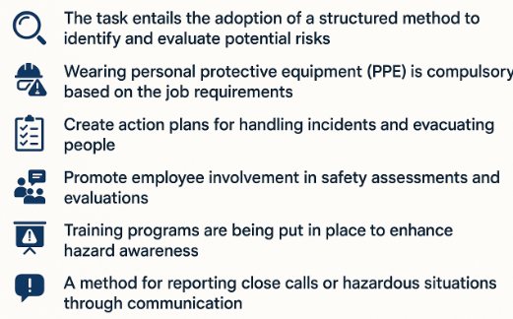
ISO 45001 HAZARDS AND SAFETY REQUIREMENTS
Safety Requirements under ISO 45001
The task entails the adoption of a structured method to identify and evaluate potential risks.
Wearing personal protective equipment (PPE) is compulsory based on the job requirements.
Create action plans for handling incidents and evacuating people.
Promote employee involvement in safety assessments and evaluations.
Training programs are being put in place to enhance hazard awareness.
A method for reporting close calls or hazardous situations through communication.

Slide 15
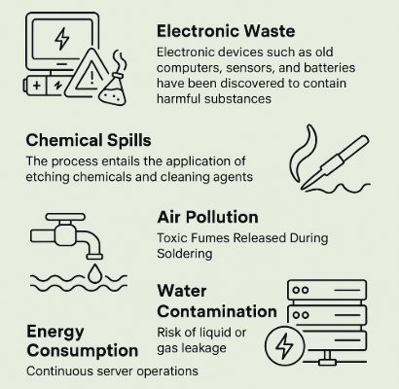
ISO 14001 HAZARDS AND ENVIRONMENTAL SAFETY REQUIRMENTS
Key Environmental Hazards Identified at RISETECH
Electronic Waste Electronic devices such as old computers, sensors, and batteries have been discovered to contain harmful substances.
Chemical Spills The process entails the application of etching chemicals and cleaning agents.
Air pollution Toxic Fumes Released During Soldering.
Water Contamination Risk of liquid or gas leakage.
Energy consumption Continuous server operations

Slide 16
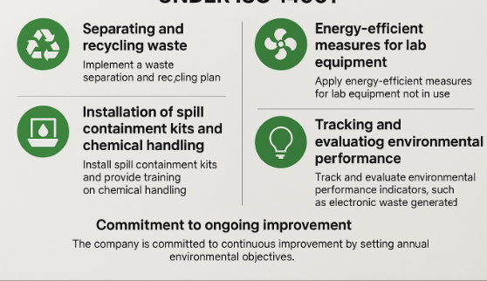
ISO 14001 HAZARDS AND ENVIRONMENTAL SAFETY REQUIRMENTS
Environmental Safety Requirements under ISO 14001
Create a plan for separating and recycling waste.
The plan entails the installation of spill containment kits and the provision of chemical handling training.
It entails ensuring proper ventilation in soldering and pcb areas.
Apply energy-efficient measures for lab equipment that is not in use.
It entails tracking and evaluating environmental performance indicators, including the amount of electronic waste generated.
The company is dedicated to ongoing progress by establishing yearly environmental objectives.

Slide 17
CONCLUSION
The HSE audit of RISETECH highlights both the strengths and weaknesses in the existing environmental and safety practices.
While there is a decent level of compliance with ISO 45001 and ISO 14001, there is still room for improvement in terms of documentation, conducting regular internal audits, and formalizing procedures.
The organization's safety culture and environmental integrity will be significantly improved through the implementation of performance reviews, formalized training, and waste documentation.
By adhering to these global guidelines, RISETECH can create a secure and eco-friendly workplace that fosters creativity and scientific exploration.

Slide 18
REFERNECES
[1] International Organization for Standardization, ISO 45001:2018 – Occupational Health and Safety Management Systems – Requirements with Guidance for Use, Geneva, Switzerland: ISO, 2018.
[2] International Organization for Standardization, ISO 14001:2015 – Environmental Management Systems – Requirements with Guidance for Use, Geneva, Switzerland: ISO, 2015.
[3] RISETECH, Lab Safety Manual, Department of Computer Engineering, NUST College of EME, Rawalpindi, Pakistan, 2025.
[4] A. Smith and J. Chen, "Best Practices in Laboratory Safety: A Global Perspective," Journal of Occupational Health and Safety, vol. 64, no. 2, pp. 134–142, 2023.
[5] National Institute for Occupational Safety and Health (NIOSH), Material Safety Data Sheets (MSDS) for Common Laboratory Chemicals, U.S. Department of Health and Human Services, 2022. [Online]. Available: https://www.cdc.gov/niosh/docs/
[6] Occupational Safety and Health Administration (OSHA), Guidelines for Electronic Waste Disposal and Management, U.S. Department of Labor, 2021. [Online]. Available: https://www.osha.gov
[7] Pakistan Environmental Protection Agency (SEPA), National Environmental Quality Standards for Industrial Emissions, Government of Pakistan, Islamabad, 2020. [Online]. Available: https://environment.gov.pk

Slide 19


